Slide 1
The Tavistock Community
a place to connect with others, to exchange ideas, to develop practice, expand learning and think & create together, all underpinned by TAVISTOCK METHODOLOGIES

Slide 2
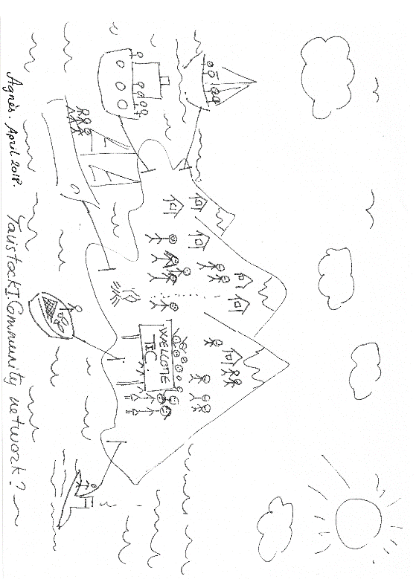
Why a Tavistock community?
The idea to create a Community for alumni and friends of the Tavistock Institute around the world, originated during an open space event at the Institute’s 70th Festival celebrations.
The Community will provide practitioners of Tavistock methodology a place to connect with others, to exchange ideas, to develop practice and expand learning, using Tavistock approaches.
“I want to feel connected with like-minded people, meet new people, share learning and learn about others, join conferences, talks, concerts and exhibitions! Who knows?! It would be a privilege to be part of it.“ Agnès Berthoz, Asset-Programme Manager, Octavien Ltd

Slide 3
What IS THE Nature OF the Tavistock community?
Continuing the Learning...
Emerging and evolving
Self-organising
A developing / learning Community:
You have the opportunity to shape it - the community forms through member engagement and continues to evolve.
Framework provided by the Tavistock Institute
“ I would like to meet with people, recently qualified in PD and Leadership coaching who, like me, wish to develop their coaching practice from scratch. Someone who would like to engage about this new experience . I am also happy with the next steps outlined in the presentation” Agnès Berthoz, Asset-Programme Manager, Octavien Ltd

Slide 4
What does the community offer?
Share your knowledge & expertise
learn, Educate
FINDING PARTNERSHIPS AND SAME-INTEREST GROUPS
resources
BUILDING TOGETHER
FINDING OTHERS ‘IN THE SAME SHOES’
Learn how others are working with the same challenges
Encouragement
Academic, practical
CREATING THE NEW
Inspiration
NETWORKING
Mutual peer support
Building your PRACTICE & YOUR profile
friendship
A CONTAINING SPACE
RESEARCH
exploration

Slide 5
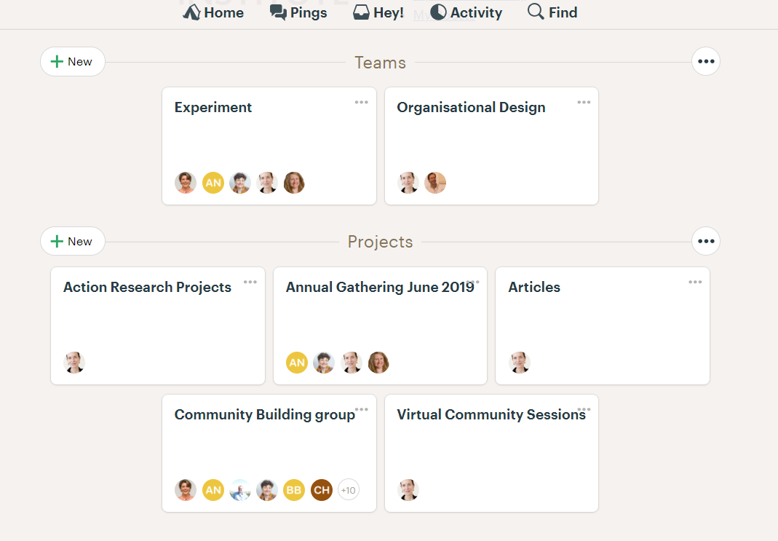
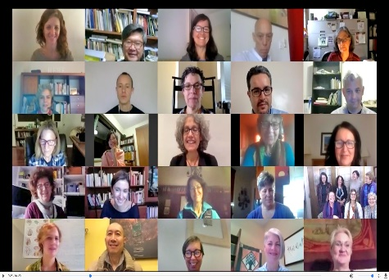
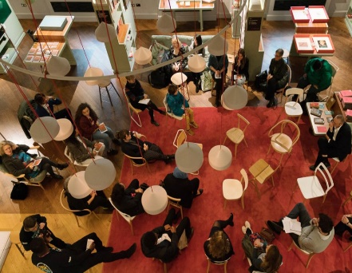
How will the community look?
An online collaboration platform - Basecamp
COMMUNITY presentations / NETWORK EVENTS
Local and online community cafÉs
An opportunity to connect, share and work together with previous and future participants of the programmes/conferences held by The Tavistock Institute, including long-time friends and associates, whether online or in person.

Slide 6
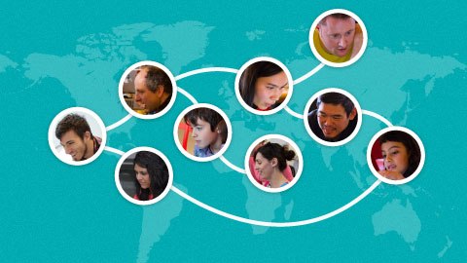
An Online collaboration platform - Basecamp
Create projects and teams to work on action research together
Share articles or presentations for peer-feedback
Community Conversations – regular discussion of hot topics
Online mentoring (possibly paid for) on the progress of your project
Regular inclusive meetings / discussion forums

Slide 7
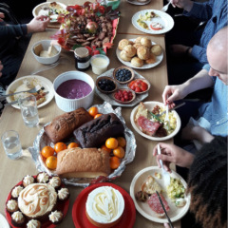
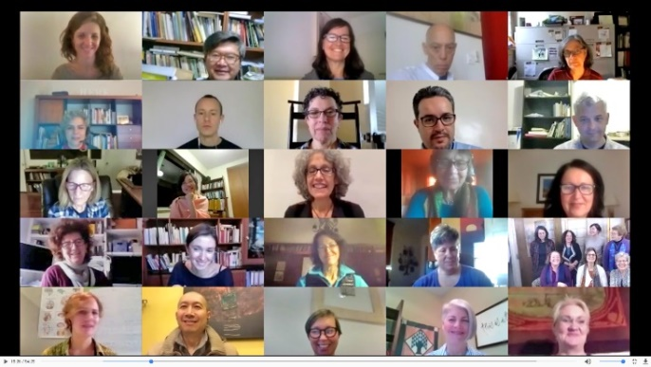
Community sessions
Sign up to online community live sessions
Live events repeated online, globally accessible
Members can host a session and present their topic
Regular Community Conversations
Other presentations brought in
TIHR Food for Thought Lunchtime Talks
  Recording is provided online
  Followed up with online discussion on the talk

Slide 8
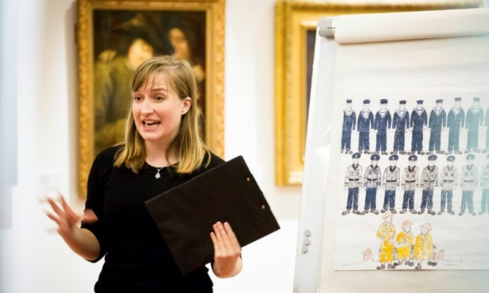

Member network events
Attend the TC Annual Gathering – 24 June 2019
  together with the TIHR Graduation certification
Open Space events
Community Café events - connect and get together with other members locally or around interests
Reduced fees to or free-of-charge TC conferences / events

Slide 9
Member benefits
Connect and create with other TIHR alumni and Friends of the Institute
Access to an international network of professionals who use Tavistock methodologies:
Group Relations; Systems Psychodynamics; Action Research; Action Learning; Social Dreaming; Socio-Technical, Socio-Psychological, Socio-Ecological; For leadership; OD and change consultancy; coaching; supervision; evaluation; embodiment; working with the arts
Sharing thoughts/ideas, research, insights, good practice, case studies and thought leadership:
  Action learning sets / reflective practice groups
  Host a presentation – build your profile
  Virtual peer-mentoring support

Slide 10
Member benefits
Community Conversations / chats about methodologies - regular online hot topic discussions
Network of Community Cafés – build your own local hub. Become a steward…
Reduced fees to TC conferences / events
Group discounts for TIHR Professional Development programmes – TC subscription only
Reduced subscriptions for journals: Human Relations; Evaluation; Journal of Applied Behavioural Science – TC subscription only
Synergies with:
  Food for Thought Lunchtime Talks? – discussion groups afterwards
  International Group Relations community (Belgirate)?
  ODNE? EODF?

Slide 11
Member EXPECTATIONS
Your voice, actions and skills
Community-building: building relationships
Community-building: local hubs – around location or interest: create a Community Café – you can take up the role of steward
Using Tavistock approaches

Slide 12
Become a tavistock community member
Register online
First year, 2019-2020 – free for everyone, valid until Annual Gathering, end June 2020 then by subscription
Register your particular interests
Level of involvement – for example, can you steward a Community Café?
Registration process next steps: approval (inc timeline) – invitation to join TC on Basecamp

Slide 13
Next steps
Monday, 24 June 2019:
Tavistock Community Annual Gathering
  Pre-Launch communications
  Planning and preparations

